Slide 1


Moving towards a practical and effective constraint-induced therapy protocol for chronic stroke patients: a systematic review and meta-analysis
Presented by Dr. Pavlina Psychouli
C. Anastasiou, Dr. I. Mamais, N. Papasalourou
No financial disclosures

Slide 2
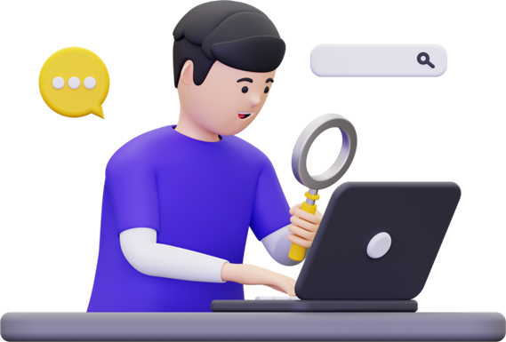

Constraint Induced Movement Therapy (CIMT)
Basic Components
  Intensive functional practice (6 hrs/ day)
  Splint/ mitt
  Transfer Package (TP)
More than 1000 research studies

Slide 3



The clinical dilemma
CIMT original protocol is difficult to implement in routine clinical practice
mCIMT
less intensive training & restraint use
transfer package (TP): reduced or omitted
•demonstrated superiority compared to traditional approaches
•limited evidence for one, specific mCIMT protocol
What version of CIMT actually works in the real world?

Slide 4
Our previous work
Results
Categorization of mCIMT protocols for stroke patients
total treatment duration:
low (<20 hrs), moderate (21-39 hrs) or high (>40 hrs)
splint-wearing time:
low (≤3 hrs/day), moderate (4-9 hrs/day) or high (≥10 hrs/day)
The most frequently used mCIMT protocols
  moderate-to-low total treatment duration (less than 39 hrs)
  moderate-to-high restriction time (more than 10 hrs per day).

Slide 5

Study aim
to systematically review and investigate the functional effects on upper limbs of the most widely implemented mCIMT protocols reported in the literature
PubMed, Scopus, EBSCO & Cochrane Library

Slide 6
Study Selection
chronic stroke adults
mCIMT (no more than 39 hrs of therapist-supervised training and at least 10 hrs/day of restraint)
OT/ PT intervention (no combinations, no pharmaceutical treatment)
upper limb motor function tests
RCTs

Slide 7
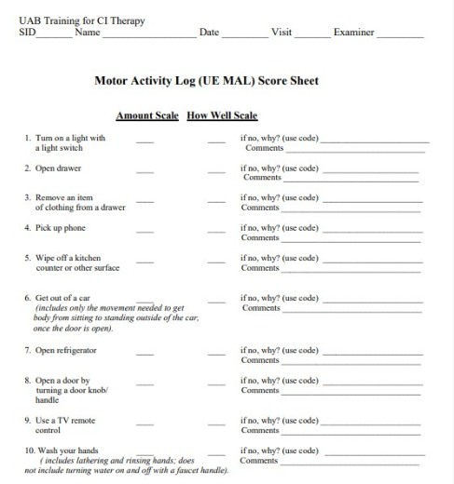
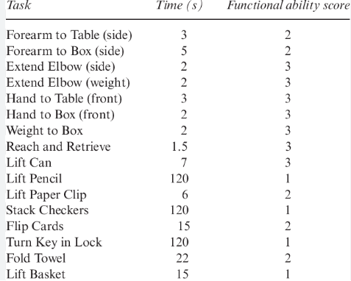
Results
  5 studies, total sample= 239
  19-78 participants (mean age: 49.5-69.9 years)
  treatment duration: 2 to 8 weeks
  most frequently used outcome measures: MAL & WMFT
  follow-up measurements: 3 studies (1mo, 3mo, 6mo post-intervention)
  methodological quality (RoB2):
  3 studies= “high” risk,
  2 studies= “some concerns”

Slide 8
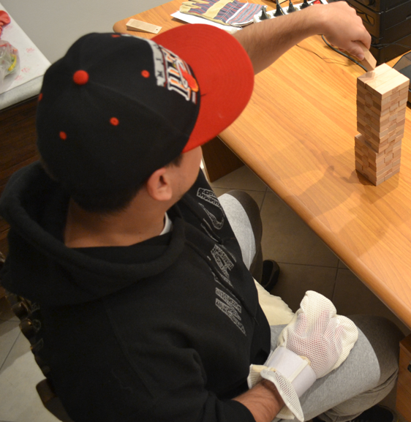
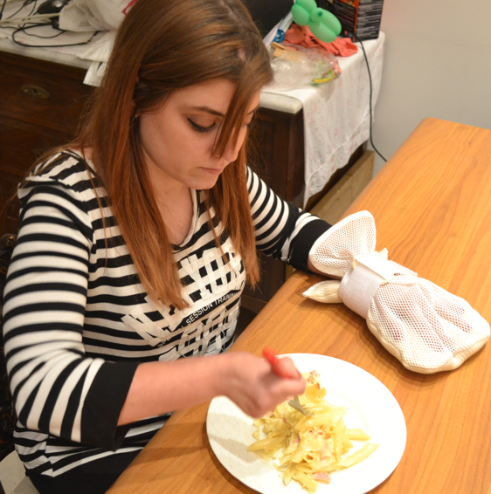
intervention description
Study | mCIMT protocol
Smania et al. 2012 | Total therapist-supervised time: 10 hrs/ splint time: 120 hrs 5 days/ week for 2 weeks · 1 hour @clinic · Splint wearing: at least 12 hrs daily · 1 hr of home-based program
Trinh et al. 2016 | Total therapist-supervised time: 10 hrs/ splint time: 120 hrs 5 days/ week for 2 weeks · 1 hour @clinic · Splint wearing: 90% of waking hours · No clear duration of home-based program
Baldwin et al. 2018 | Total therapist-supervised time: 6 hrs/ splint time 200 hrs 6 sessions in 2 weeks · 1 hour @clinic · Splint wearing: 90% of waking hours · 42 min of home-based program
Rocha et al. 2021 | Total therapist-supervised time: 24 hrs 3 days/ week for 8 weeks ·1 hour @clinic ·No clear duration of splint time ·No clear duration of home-based program
Gauthier et al. 2022 | Total therapist-supervised time: 35 hrs/ splint time: 210 hrs 10 sessions in 3 weeks · 3.5 hrs @clinic · Splint wearing: 10 hrs daily · 5 hrs of home-based program

Slide 9
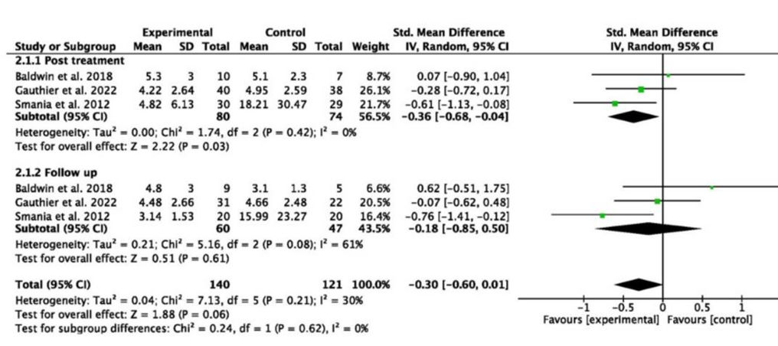
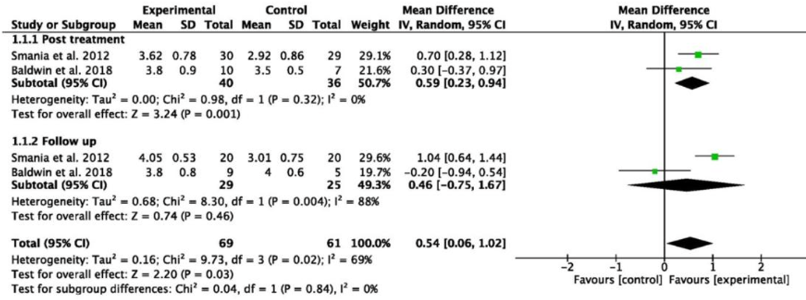
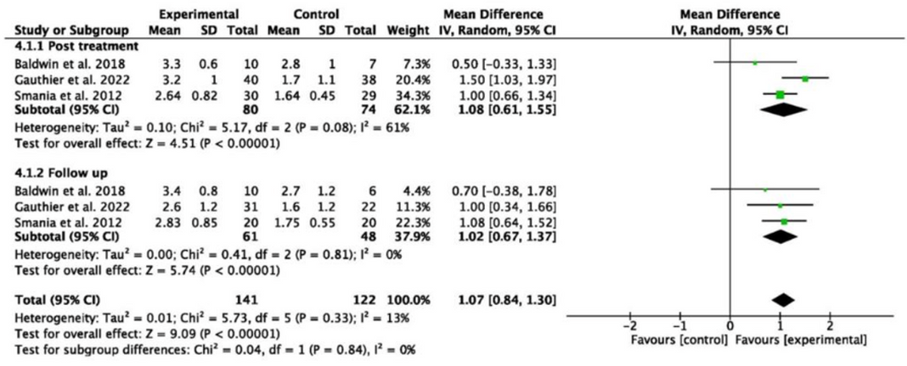
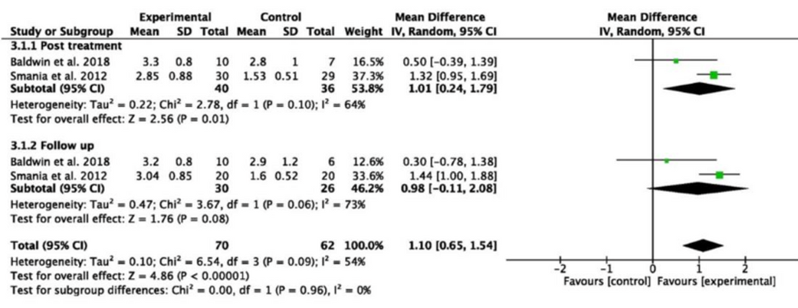
Meta-analysis
WMFT performance time
WMFT functional ability
MAL-QoM
MAL-AoM

Slide 10
discussion
Findings in alignment with previous literature:
  measurable benefits even with reduced intensity schemes
  better MAL outcomes with a constraint of at least 6 hrs/day and 6 hrs of training/week. Daily intervention time did not lead to a significant difference in functional upper limb performance
  the intervention period should be at least 2 weeks, and each training session should last between 30-60 minutes/day to yield positive outcomes

Slide 11
discussion
The importance of including elements of the transfer package (TP):
  Lack of TP may reduce overall effectiveness
  When elements of TP are included, the nature of the therapy shifts from an “intensity-driven” model to a “distribution-of-practice”.0 model
  Less therapist-led time, more self-directed activities in the real world
  This may explain effectiveness of mCIMT protocols with limited clinic-based training

Slide 12
References
  Bang DH, Shin WS, Choi HS. Effects of modified constraint-induced movement therapy with trunk restraint in early stroke patients: A single-blinded, randomized, controlled, pilot trial. NeuroRehabilitation. 2018
  Gauthier LV, Nichols-Larsen DS, Uswatte G, Strahl N, Simeo M, Proffitt R, et al. Video game rehabilitation for outpatient stroke (VIGoROUS): A multi-site randomized controlled trial of in-home, self-managed, upper-extremity therapy. EClinicalMedicine. 2022
  Morris DM, Taub E, Mark VW. Constraint-induced movement therapy: characterizing the intervention protocol. Eura Medicophys. 2006
  Page SJ, Sisto S, Levine P, McGrath RE. Efficacy of modified constraint-induced movement therapy in chronic stroke: a single-blinded randomized controlled trial. Arch Phys Med Rehabil. 2004
  Psychouli P, Mamais I, Anastasiou C. An Exploration of the Effectiveness of Different Intensity Protocols of Modified Constraint-Induced Therapy in Stroke: A Systematic Review. Rehabil Res Pract. 2023
  Smania N, Gandolfi M, Paolucci S, Iosa M, Ianes P, Recchia S, et al. Reduced-intensity modified constraint-induced movement therapy versus conventional therapy for upper extremity rehabilitation after stroke: A multicenter trial. Neurorehabil Neural Repair. 2012
  Yang YK, Lin CY, Chen PH, Jhou HJ. Timing and Dose of Constraint-Induced Movement Therapy after Stroke: A Systematic Review and Meta-Regression. J Clin Med. 2023

Slide 13
P.Psychouli@euc.ac.cy

